Slide 1

The Existential Significance of the Digital Divide for America’s Historically Underserved Populations

Slide 2
Submitted To:
Md. Iftekhar Alam Efat
Lecturer
IIT, NSTU
Presented By:
MD Mynuddin (ASH1825007M)
Moonmoon Das (BKH1825027F)
Akash Chandra Debnath (ASH1825037M)

Slide 3
Contents
Introduction
Background
Impact
Solutions
Conclusion
References

Slide 4
What is Digital Divide?
The term digital divide was first popularized in the 1990s.
It describes the technology divide (or gap) between countries, demographic groups and economic areas. It is a technical, social and economic issue, which covers the difference in availability and use of modern technology.
The divide that people experience can depend on many aspects, such as age, status and location.

Slide 5

What is Digital Divide? (Cont…)
Many people believe that the digital divide refers merely to internet access, but it can refer to access to several forms of modern technology, including telephones, television, personal computers (PCs) and the internet.

Slide 6
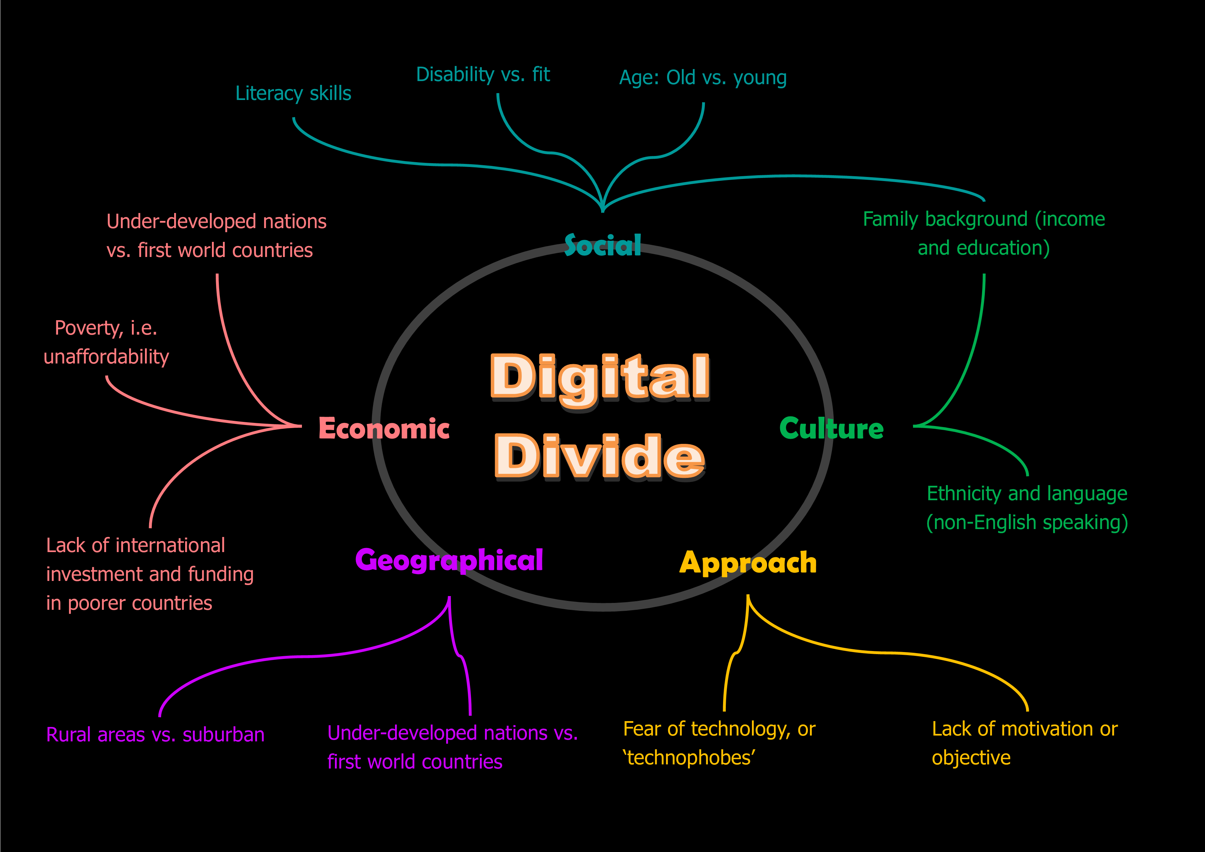
Digital Divide -A critical analysis

Slide 7
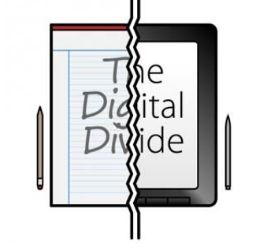
The Digital Divide in the United States

Slide 8
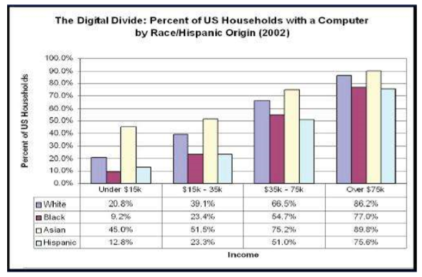
Socio-economic Factor
While 64% of Americans have access to broadband, low income families, African American and Hispanic households, and disabled Americans are being left behind in the "digital divide”.
There is a clear divide among various ethnic groups.

Slide 9
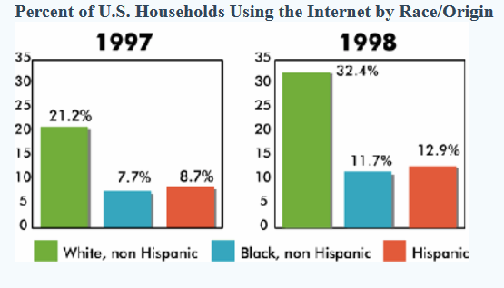
Comparison Chart

Slide 10
Socio-economic Factor (Cont...)
Interestingly, race affects the amount of computers in the school. Schools with a higher percentage of minorities have fewer computers whereas those with a lower percentage of minorities have a greater number of computers.
With regard to Internet access, Black and Hispanic households are falling even further behind access by White households grew by 37.6% between 1997 and 1998.
The NTIA study also demonstrated the racial disparities in Internet access exist irrespective of income. In a cultural study to determine reasons for the divide other than income, the Hispanic, African-American, and Asian-American communities were studied.

Slide 11
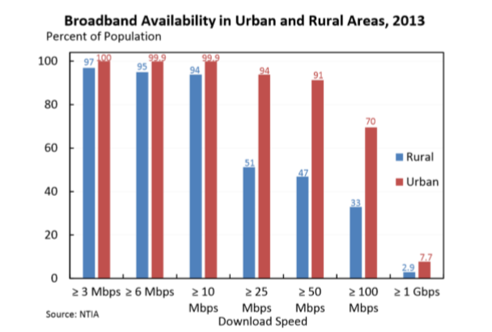
Rural Factor
28% of rural Americans have no access to broadband
41% of American schools have no access to high-speed internet
75% of Americans have no choice in high-end broadband provider

Slide 12
Age Factor
Age is a factor that tell us if an individual has used the internet before.
Adults age 16-24 (99%) has used the internet.
Adults 75 and older has increased about 13% since 2011.
Older adults will not have the same skills as younger adults because younger adults have been using longer and have developed more skills.

Slide 13
Age Factor (Cont…)
Americans 55 and older have always shown the lowest level of broadband usage, while Americans ages 18–24 have exhibited the highest levels of usage: in 2001, 3.1% of households 65 years and older, 10.1% of households 45–64 years of age, and 11.3% of households 16–44 years of age connected to the Internet at home.
By 2009, 39.9% of households 65 years and older, 68.2% of households 45–64, and 71.2% of households 16–44 reported connecting to the Internet.
Usage rates are increasing rapidly, but older Americans still have the lowest levels of Internet connectivity.

Slide 14
Statistics
It was found that 97 percent of 18 to 29 years old in the United States were internet users. Overall, 87 percent of the U.S. population accessed the internet.
18 to 29=97%
30 to 49=93%
50 to 64=88%
65 and older=57%

Slide 15
Gender Factor
By 2001, women had surpassed men as the majority of the online United States population.
The 2009 Census data suggests that potential disparities in gendered connectivity have become nearly nonexistent; 73% of female citizens three years and older compared to 74% of males could access the Internet from their home.
Although more women in the United States use the Internet than men, there still remains significant gender gaps in content creation and website development.

Slide 16
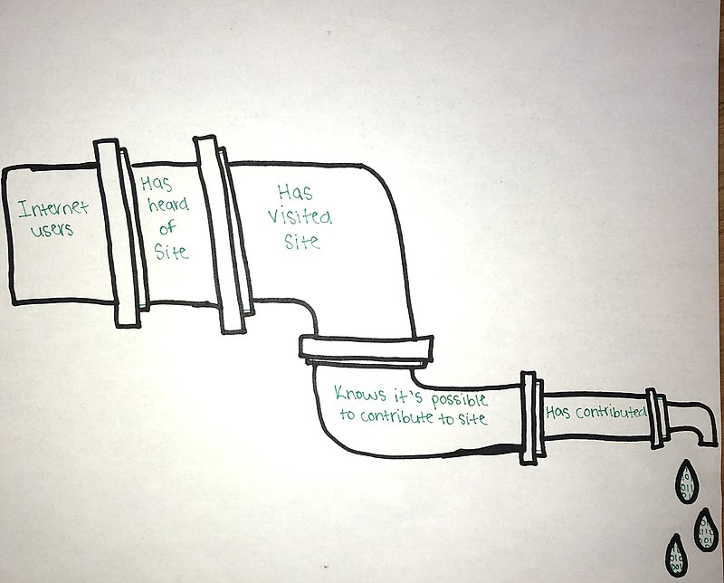
Reasons given for trends and gaps
Figure: Pipeline Model described by Shaw & Hargittai.

Slide 17
Impact
Impact of Digital Divide on the Economy:
Telecommunication services boost economic growth.
Broad use of the internet enables an economically productive nation.
People can engage in online shopping eliminating the hustle of commuter traffic. Paperless transactions are a convenient approach to creating economic empowerment.
The economic gap widens especially with developing countries which lack adequate ICT integration.
Impact of Digital Divide on Education:
The internet is a rich library of information. More than ever there are numerous educational platforms where you can learn advanced skills.
Access to ICT has been linked to academic success and excellent scientific research.
Education empowers the mind. It is crucial to keep up with this dynamic sector for remarkable success to an individual and society.

Slide 18
Impact (Cont…)
Impact of Digital Divide on Social Spheres:
Internet access drives communication.
Social media platforms such as Facebook create engagement, build relationships, and connect us to family and friends.
We can access information faster than relying on traditional newspapers.
Art and music have been dramatically revolutionized by technology. These are benefits that internet deprived societies lack.
Elimination of the digital divide is essential to empower developing countries.

Slide 19
Solutions
The digital divide creates new technological barriers between insiders and outsiders . These barriers need to be dismantled through programs that address both the instrumental and social aspects of the divide.
Now we can follow some steps which can solve the problems. These are-
Increase affordability: Offer financing to help lower income earners afford new technology. Governments can give tariff subsidies to encourage them to buy these digital tools.

Slide 20
Solutions (Cont…)
Empowering users: An issue that broadens the digital divide is ‘participation inequality’ where users lack the skills to use it. To avoid this, the public needs to be educated on the benefits and value of utilizing the internet and the various resources within it to achieve economic and social growth.
Improve the relevance of online content: To encourage internet adoption in rural places, local content and applications need to be developed in local languages that can be understood by the local populace

Slide 21
Solutions (Cont…)
Internet infrastructure development: Large-scale cost-effective solutions that are suited for rural environments have been developed such as the use of satellite broadband technologies, drones, and earth-orbiting balloons.
Address gender gap in internet access: To close this gender gap lies squarely on both government and non-governmental organizations which must work together. Addressing the issues of poverty, relevance and public awareness will also considerably address the plight of women without access to the internet.

Slide 22
Conclusion
In summary, the problem of the digital divide is just a symptom that points us to a much deeper problem in our economic development. Once the economic challenges of low education levels, poor infrastructure development, and low quality of life or income levels are addressed, the digital divide will be eliminated.

Slide 23
References
Lynette Kvasny , The Pennsylvania State University, USA,The Existential Significance of the Digital Divide for America’s Historically Underserved Populations .
Digital divide , Wikipedia The free encyclopedia ,[online], 22 July 2020, https://en.wikipedia.org/wiki/Digital_divide
CS Stanford ,Digital Divide ,[online], 22 July 2020 , https://cs.stanford.edu/people/eroberts/cs181/projects/digital-divide/start.html
Digital Divide Council ,Digital Divide , [online], 22 July 2020 , http://www.digitaldividecouncil.com/what-is-the-digital-divide/?fbclid=IwAR1eUuVWbZWwz91eqbzzY1HLqxfn1hUYJ6WsDpVgHZliTgZeuAGRvGCa91c
Lumen Learning ,Cultural Anthropology , [online], 22 July 2020 , https://courses.lumenlearning.com/culturalanthRopology
/chapter/the-global-digital-divide/
OECD , Bridging the Digital Divide , [online], 22 July 2020 , https://www.oecd.org/site/schoolingfortomorrowknowledgebase/themes/ict/bridgingthedigitaldivide.htm

Slide 24


